Slide 1
Data Science and Artificial Intelligence From MS Excel to Python
Felix Gonzalez, P.E.
felix.gonzalez@gmail.com
fgonzaleumbc/DATA601.com

Slide 2
What is Python
Object-oriented, high-level programming language.
0 index programming language.
Relatively simple syntax with focus on readability.
Built-in and third-party modules, packages, and libraries reusable across projects.
Open Source.
Cross-platform: Windows, Mac OS, Linux, Android and iOS
Large and growing community.

Slide 3
Python Tools
Various tools allow running python code.
Integrated Development Environments (IDE):
Jupyter Notebooks
MS Visual Studio Code
Google Colab
Anaconda Spyder
PyCharm
Text editors can edit Python source code and run using Python command line terminal or command prompt via its interpreter.
Python runs locally or deployed in cloud services.
Other Tools:
Github
Many Modules, Packages, and Libraries
Notes:
References:
- Python Documentation Python Documentation https://www.python.org/doc/ and https://docs.python.org/3/.
- Python style guide: https://peps.python.org/pep-0008/

Slide 4
Jupyter Notebook Overview
IDE that runs in the browser.
Platform to write, execute, and visualize code.
Syntax highlighting, code completion, and embed visualizations directly in the notebook.
Allows line-by-line or cell-by-cell code execution.
Can be easily shared. Highly used in academic settings, data analysis, code testing, documentation, comparisons, and other purposes.

Slide 5
Anaconda Overview
Distribution package that includes Python, and Data Science Libraries curated by Anaconda.
Costs:
Free for academic/educational use.
$600/yr individual license for commercial use.
Anaconda 2024 is on DOE’s EITS pre-approved software list.

Slide 6
Python Overview
Python documentation: https://docs.python.org/3/
Built-in capabilities:
Working with various data types (e.g., Boolean, integers, floats, text string, datetimes, etc.)
Data structures and types (lists, sets, dictionaries)
Various Statements:
For and while loops
If/else statements
Modules for working with math, functional programming, various file formats
Built-in capabilities expanded via installation of modules
Notes:
Modules can be installed individually or via

Slide 7
Important Data Science Libraries (1/2)
Library/ Package Title | Included in Anaconda* | Category | Description and main use
PIP | Yes | Code | Pip is the package installer for Python.
Pandas | Yes | Data | Pandas is a Python package that provides fast, flexible, and expressive data structures designed to make working with "relational" or "labeled" data both easy and intuitive.
Numpy | Yes | Math | Numpy is a powerful N-dimensional array object, sophisticated (broadcasting) functions, tools for integrating C/C++ and Fortran code, useful linear algebra, Fourier transform, random number capabilities, and much more.
Matplotlib | Yes | Graph | Matplotlib is a comprehensive library for creating static, animated, and interactive visualizations in Python.
Plotly | Yes | Graph | Plotly.py is an interactive, open-source, and browser-based graphing library for Python.
Seaborn | Yes | Graph | Seaborn is a Python visualization library based on matplotlib. It provides a high-level interface for drawing attractive statistical graphics.
Re (Regex or Regular Expressions) | Yes | Text | This package pertains specifically to regular expressions embedded inside Python and compiled with Python's [`re`] (https://docs.python.org/3/library/re.html) module.
OS | Yes | OS | This module provides a portable way of using operating system dependent functionality.
Requests | Yes | Web | Requests is a simple, yet elegant, HTTP library.
BeautifulSoup4 | Yes | Web | Beautiful Soup is a library that makes it easy to scrape information from web pages. It sits atop an HTML or XML parser, providing Pythonic idioms for iterating, searching, and modifying the parse tree.
Scrapy | Yes | Web | Scrapy is a fast high-level web crawling and web scraping framework, used to crawl websites and extract structured data from their pages.
Selenium | No | Web | Python language bindings for Selenium WebDriver. The selenium package is used to automate web browser interaction from Python. Can be used for dynamic JavaScript based websites.
Scikit-learn | Yes | ML | Scikit-learn is a Python module for machine learning built on top of SciPy and is distributed under the 3-Clause BSD license.
Scipy | Yes | Math | SciPy is open-source software for mathematics, science, and engineering. The SciPy library depends on NumPy, which provides convenient and fast N-dimensional array manipulation.
*As of Fall 2024 release.

Slide 8
Important Data Science Libraries (2/2)
Library/ Package Title | Included in Anaconda* | Category | Description and main use
Scipy | Yes | Math | SciPy is open-source software for mathematics, science, and engineering. The SciPy library depends on NumPy, which provides convenient and fast N-dimensional array manipulation.
Statsmodels | Yes | Math | Statsmodels is a Python package that provides a complement to scipy for statistical computations including descriptive statistics and estimation and inference for statistical models.
spaCy | No | NLP | SpaCy is a library for advanced Natural Language Processing in Python and Cython.
NLTK | Yes | NLP | The Natural Language Toolkit (NLTK) is a Python package for natural language processing.
Gensim | Yes | NLP | Gensim is a Python library for topic modelling, document indexing and similarity retrieval with large corpora.
SQLite | Yes | DB | SQLite is a C library that provides a lightweight disk-based database that doesn’t require a separate server process and allows accessing the database using a nonstandard variant of the SQL query language.
Openpyxl | Yes | Excel | Openpyxl is a Python library to read/write Excel 2010 xlsx/xlsm/xltx/xltm files.
Networkx | Yes | Network | NetworkX is a Python package for the creation, manipulation, and study of the structure, dynamics, and functions of complex networks.
Ipywidgets | Yes | Dashboard | Ipywidgets, also known as jupyter-widgets or simply widgets, are interactive HTML widgets for Jupyter notebooks and the IPython kernel.
Panel | Yes | Dashboard | Panel provides tools for easily composing widgets, plots, tables, and other viewable objects and controls into custom analysis tools, apps, and dashboards
Flask | Yes | Web | Flask is a lightweight WSGI web application framework. It is designed to make getting started quick and easy, with the ability to scale up to complex applications.
Django | No | Web | Django is a high-level Python web framework that encourages rapid development and clean, pragmatic design.
TensorFlow | No | DL | TensorFlow is an open-source software library for high performance numerical computation (https://www.tensorflow.org/)
TensorFlow Keras | No | DL | Keras is TensorFlow’s module for deep learning.
Pytorch | No | DL | PyTorch is a Python package that provides two high-level features: (1) Tensor computation (like NumPy) with strong GPU acceleration and (2) Deep neural networks built on a tape-based autograd system.
*As of Fall 2024 release.

Slide 9
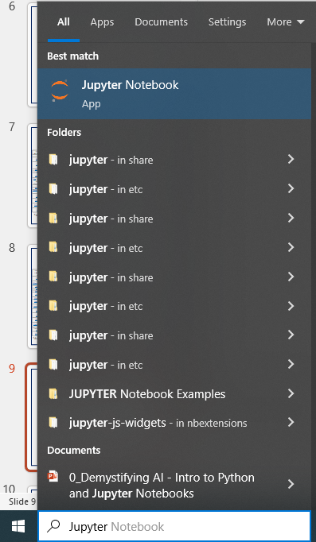
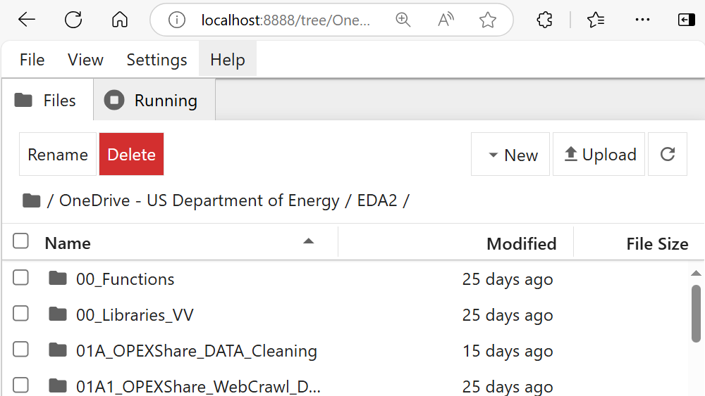
Jupyter Notebook Overview (1/3
Multiple ways to Open
Windows app search
Opens user interface in default browser

Slide 10
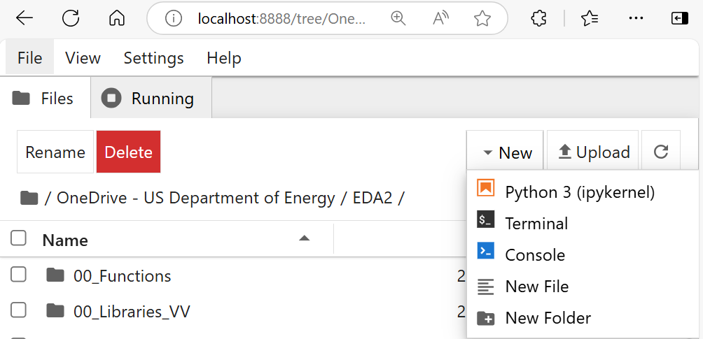
Jupyter Notebook Overview (2/3)
Jupyter Notebook user interface components
Open
Jupyter
Notebooks
File
Explorer
File Rename
or Delete
New Python
Jupyter
Notebook
Folders
and Files

Slide 11
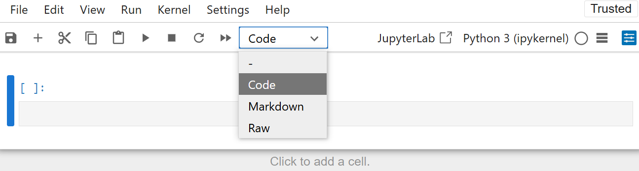
Jupyter Notebook Overview (3/3)
Jupyter Notebook important options
Cut
Selected
Cell
Run
Selected
Cell
Type of Cell
(Code or Markdown)
Save
Empty
Code Cell
Add Empty Cell
Interrupt or Stop running cell
Copy Cell
Add Empty Cell

Slide 12
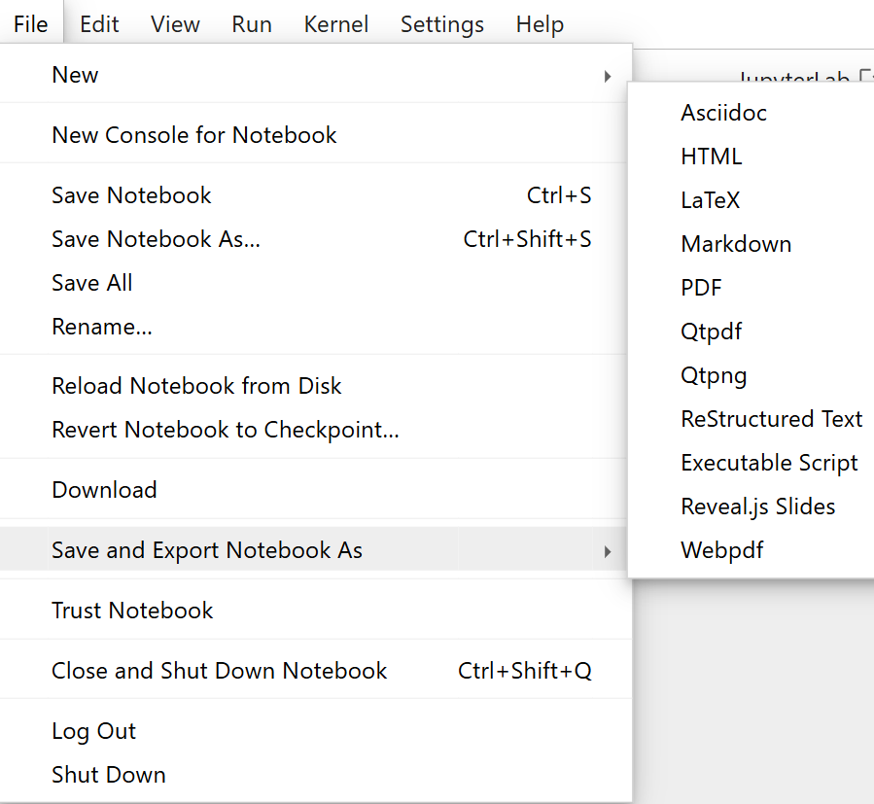
Jupyter Notebook File Menu
Export
As HTML
Save
Notebook
Export
Notebook
Preferred Method to close a Notebook
Notes:
Sharing a notebook can be done in multiple ways. One is to share the .ipynb file. Note that you will need to include files being loaded for the notebook to run correctly. Alternatively, the notebook can be exported as a static export. The HTML allows the notebook to be open in an internet browser and if the notebook was exported after all cells ran, the HTML will also show the output. This is ideal to share the notebook with people who do not have Python installed.

Slide 13
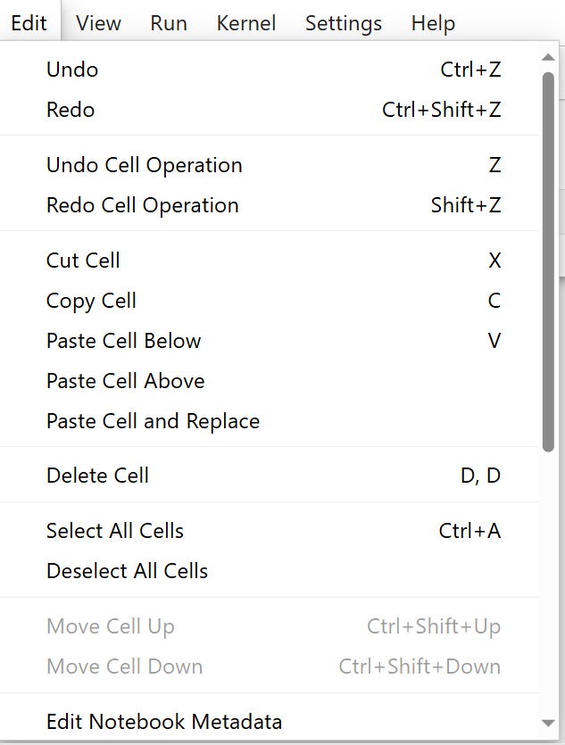
Jupyter Notebook Edit Menu
Be careful with delete, cut/paste, and undo/redo operations. These don’t always work as expected and may cause loss of information.

Slide 14
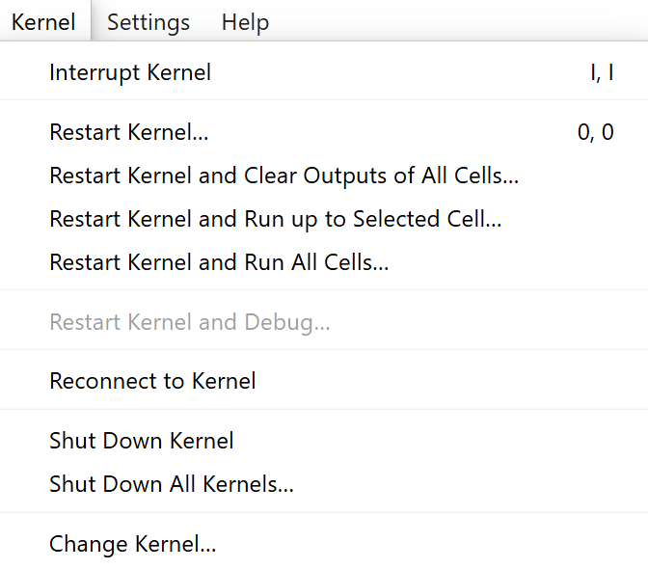
Jupyter Notebook Kernel Menu
Restart notebook and removes objects from memory.
Useful for restarting and running a notebook
up to a point.
Restarts notebook and run all cells

Slide 15
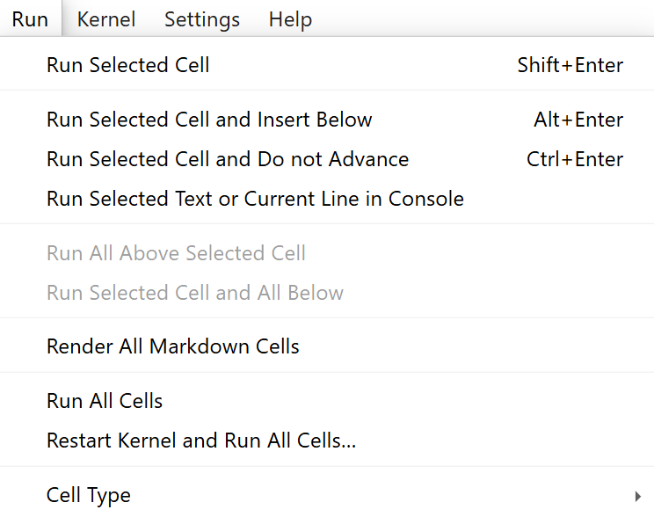
Jupyter Notebook Run Menu
Useful for running a notebook up to a point without deleting objects in memory.
Restarts notebook and run all cells
Notes:
When restarting a notebook all objects are removed from the memory. Exercise caution when modifying notebooks and code as the value of an object can stay in memory even if the cell is deleted.

Slide 16
Concluding Remarks
Lots of publicly available resources, references, examples, data, and Jupyter Notebooks
https://www.kaggle.com/
https://github.com/
Overwhelming list of packages for math, statistics, data visualization, data processing, machine learning, natural language processing, etc.

Slide 17
Important Skills
Interpret and understanding module documentation (Shorcut: Shift+Tab).
Interpreting, understanding, and solving warnings and errors.
General programming concepts (e.g., working with objects and data collections, conditional operations, statements, loops, arithmetic operations, working with files).
Familiarity and knowledge on Data Science topics:
Data cleaning, processing, and transformation
Statistics and Exploratory Data Analysis (EDA)
Machine learning
Natural language processing
Subject matter expertise.

Slide 18
Python Demo
See notebook for demo of basic operations and important topics.

Slide 19

Questions?

